Slide 1
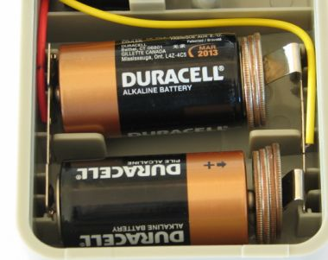
The Anatomy of a Battery
By Noah Levitin and Nandi Howard

Slide 2
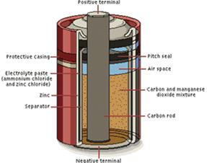
What is a Battery?
Another way to think about a battery is a tiny power plant that converts a chemical reaction into electrical energy.

Slide 3
What is in the battey?
Cathode- magnesium dioxide mixture and carbon
Separator- a non-woven fibrous materiel that separates the electrodes from the rest of the particles
Anode-are the electrodes that are oxidized and they are powered zinc metal
Electrodes-Where electrochemical reaction occurs
Electrolyte-Is the medium for the movement of ions within the cell and carries the ionic current inside the battery
Collector-A brass pin in the middle of the cell that conducts electricity to the external circuits

Slide 4
Now Try this!
http://video.google.com/videosearch?hl=en&resnum=0&q=lemon%20battery%20experiment&um=1&ie=UTF-8&sa=N&tab=wv#

